Slide 1
Clustering –Part 2
Date: 20th March 2020

Slide 2
Grid based and Density based clustering
One of the major problems with distance-based and probabilistic methods is that the shape of the underlying clusters is already defined implicitly by the underlying distance function or probability distribution.
In practice, the clusters may be hard to model with a prototypical shape implied by a distance function or probability distribution.

Slide 4
Grid-based methods
In this technique, the data is discretized into p intervals that are typically equi-width intervals.
For a d-dimensional data set, this leads to a total of p^{d} hypercubes in the underlying data.
The resulting hypercubes are the building blocks in terms of which the clustering is defined.
A density threshold τ is used to determine the subset of the p^{d} hypercubes that are dense.
Algorithm GenericGrid(Data: D, Ranges: p, Density: τ )
begin
Discretize each dimension of data D into p ranges;
Determine dense grid cells at density level τ ;
Create graph in which dense grids are connected if they are adjacent;
Determine connected components of graph;
return points in each connected component as a cluster;
end

Slide 5
In most real data sets, an arbitrarily shaped cluster will result in multiple dense regions that are connected together by a side or at least a corner.
Therefore, two grid regions are said to be adjacently connected, if they share a side in common.
A weaker version of this definition considers two regions to be adjacently connected if they share a corner in common.
Many grid-clustering algorithms use the strong definition of adjacent connectivity, where a side is used instead of a corner.
In general, for data points in k-dimensional space, two k-dimensional cubes may be defined as adjacent, if they have shared a surface of dimensionality at least r, for some user-defined parameter r < k.
This directly adjacent connectivity can be generalized to indirect density connectivity between grid regions that are not immediately adjacent to one another.
It is easy to determine such connected grid regions by using a graph-based model on the grids.

Slide 6
Grid-based Clustering Algorithms
Advantages:
1. Faster:
No distance computations
Clustering is performed on summaries and not individual objects; complexity is usually O(#-populated-grid-cells) and not O(#objects)
Easy to determine which clusters are neighboring
Shapes are limited to union of grid-cells
Challenges:
1. Scalability No. of cells < No. of data points
2. Curse of dimensionality
3. Predefined cell size and density threshold (what is a good choice of p and τ?)
2. Use of rectangular grid regions.

Slide 8
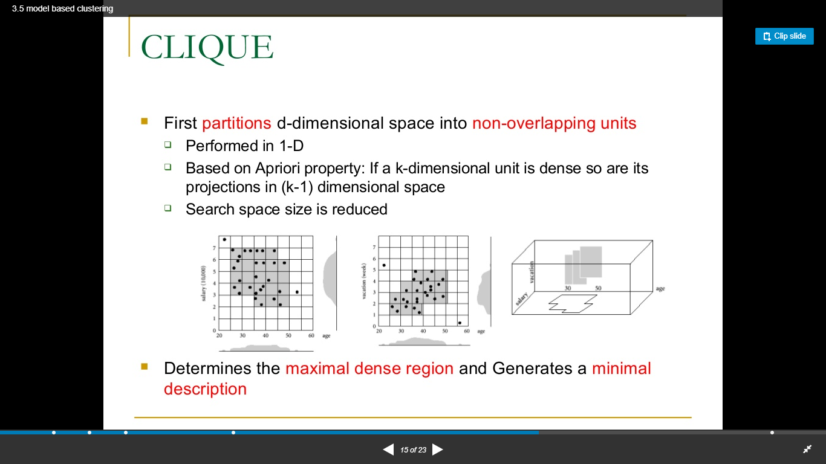
CLIQUE (Clustering in Quest)

Slide 9
Density-based Methods
The core idea in such algorithms is to identify fine-grained dense regions in the data.
These form the “building blocks” for constructing the arbitrarily-shaped clusters. These can also be considered pseudo-data points that need to be re-clustered together carefully into groups of arbitrary shape. Thus, most density-based methods can be considered two-level hierarchical algorithms.
Because there are a fewer building blocks in the second phase, as compared to the number of data points in the first phase, it is possible to organize them together into complex shapes using more detailed analysis.
Many variations of this broader principle exist, depending on the particular type of building blocks that are chosen.

Slide 10
Density-based clustering (DBSCAN)
The DBSCAN (Density-based spatial clustering of applications with noise ) approach works on a very similar principle as grid-based methods.
However, unlike grid-based methods, the density characteristics of data points are used to merge them into clusters.
Therefore, the individual data points in dense regions are used as building blocks after classifying them on the basis of their density.
Algorithm DBSCAN(Data: D, Radius: Eps, Density: Minpts )
begin
Determine core, border and noise points of D at level (Eps, Minpts);
Create graph in which core points are connected
if they are within Eps of one another;
Determine connected components in graph;
Assign each border point to connected component with which it is best connected;
return points in each connected component as a cluster;
end

Slide 11
The density of a data point is defined by the number of points that lie within a radius Eps of that point (including the point itself). The densities of these spherical regions are used to classify the data points into core, border, or noise points. These notions are defined as follows:
1. Core point: A data point is defined as a core point, if it contains at least Minpts data points.
2. Border point: A data point is defined as a border point, if it contains less than Minpts points, but it also contains at least one core point within a radius Eps.
3. Noise point: A data point that is neither a core point nor a border point is defined as a noise point.

Slide 12
Two parameters:
Eps: Maximum radius of the neighborhood
MinPts: Minimum number of points in an Eps-neighborhood of that point
N_{Eps}(p): {q belongs to D | dist(p,q) <= Eps}
Directly density-reachable:
A point p is directly density-reachable from a point q, if
1) p belongs to N_{Eps}(q)
2) core point condition: |N_{Eps} (q)| >= MinPts

Slide 13
Density-reachable:
A point p is density-reachable from a point q, if there is a chain of points p₁, …, p_{n}, p₁ = q, p_{n} = p such that p_{i+1} is directly density-reachable from p_{i}
Density-connected:
A point p is density-connected to a point q, if there is a point o such that both, p and q are density-reachable from o.
p
p₁
q
p
q
o

Slide 14
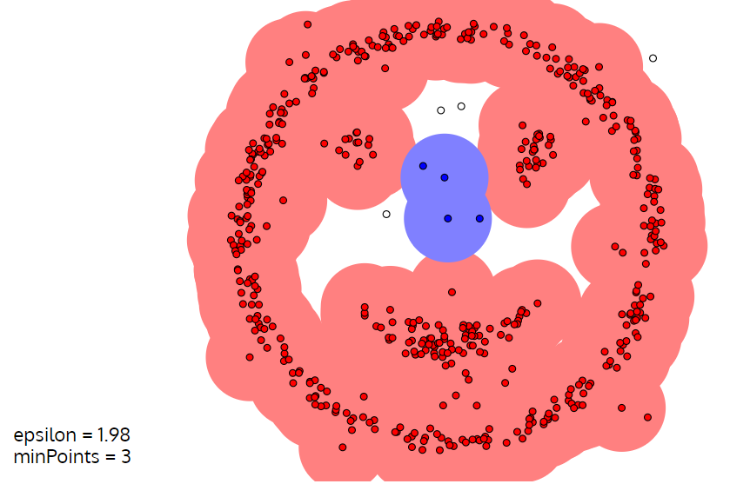
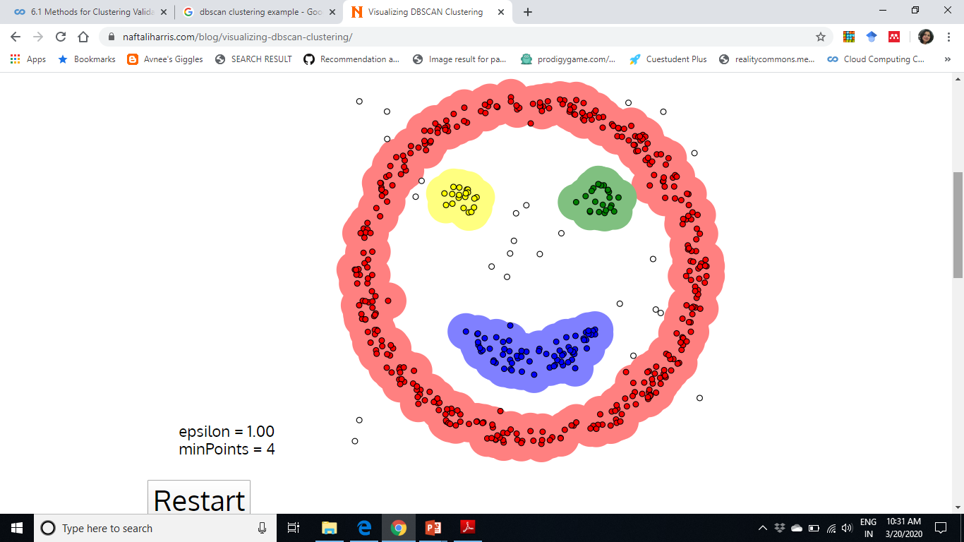
https://www.naftaliharris.com/blog/visualizing-dbscan-clustering/

Slide 15
Cluster Validation
Cluster validation is used to evaluate the quality of clusters.
Cluster validation is often difficult in real data sets because the problem is defined in an unsupervised way, thus no external validation criteria may be available to evaluate a clustering. Thus, a number of internal criteria may be defined to validate the quality of a clustering.
The major problem with internal criteria is that they may be biased toward one algorithm or the other, depending on how they are defined.
In some cases, external validation criteria may be available when a test data set is synthetically generated, and therefore the true (ground-truth) clusters are known. Alternatively, for real data sets, the class labels, if available, may be used as proxies for the cluster identifiers. In such cases, the evaluation is more effective. Such criteria are referred to as external validation criteria.

Slide 16
Internal Validation Criteria
Internal validation criteria are used when no external criteria are available to evaluate the quality of a clustering.
In most cases, the criteria used to validate the quality of the algorithm are borrowed directly from the objective function, which is optimized by a particular clustering model.
A validation criterion will always favor a clustering algorithm that uses a similar kind of objective function for its optimization.
Commonly used Internal validation criteria are as follows:
1. Sum of square distances to centroids
2. Intracluster to intercluster distance ratio
3. Silhouette coefficient

Slide 17
Sum of square distances to centroids
The centroids of the different clusters are determined, and the sum of squared (SSQ) distances are reported as the corresponding objective function. Smaller values of this measure are indicative of better cluster quality. This measure is obviously more optimized to distance-based algorithms, such as k-means, as opposed to a density-based method, such as DBSCAN.

Slide 18
Intracluster to intercluster distance ratio
This measure is more detailed than the SSQ measure.
The idea is to sample r pairs of data points from the underlying data.
Of these,
let P be the set of pairs that belong to the same cluster found by the algorithm.
The remaining pairs are denoted by set Q.
The average intercluster distance and intracluster distance are defined as follows:
Then the ratio of the average intracluster distance to the intercluster distance is given
by Intra/Inter. Small values of this measure indicate better clustering behavior.

Slide 19
Silhouette coefficient
Let Davg^{in}_{i} be the average distance of X_{i} to data points within the cluster of X_{i}.
The average distance of data point X_{i} to the points in each cluster (other than its own) is also computed.
Let Dmin^{out}_{i} represent the minimum of these (average) distances, over the other clusters. Then, the silhouette coefficient S_{i} specific to the i^{th} object, is as follows:
The silhouette coefficient will be drawn from the range (−1, 1).
Large positive values indicate highly separated clustering, and negative values are indicative of some level of “mixing” of data points from different clusters.

Slide 20
External Validation Criteria

Slide 21
Outlier Analysis
“An outlier is an observation which deviates so much from the other observations as to
arouse suspicions that it was generated by a different mechanism.”
Outliers can be viewed as a complementary concept to that of clusters.
Outliers are also referred to as abnormalities, discordants, deviants, or anomalies in the data mining and statistics literature.
Applications:
Credit card fraud
Network Intrusion detection

Slide 22
Most outlier detection methods create a model of normal patterns. Examples of such models
include clustering, distance-based quantification, or dimensionality reduction.
Consequently, most outlier detection algorithms produce an output that can be one of two types:
1. Real-valued outlier score: Such a score quantifies the tendency for a data point to be considered an outlier. Higher values of the score make it more (or, in some cases, less) likely that a given data point is an outlier. Some algorithms may even output a probability value quantifying the likelihood that a given data point is an outlier.
2. Binary label: A binary value is output, indicating whether or not a data point is an outlier. This type of output contains less information than the first one because a threshold can be imposed on the outlier scores to convert them into binary labels. However, the reverse is not possible. Therefore, outlier scores are more general than binary labels. Nevertheless, a binary score is required as the end result in most applications because it provides a crisp decision.

Slide 23
Key Models for Outlier Analysis
1. Extreme values: A data point is an extreme value, if it lies at one of the two ends of a probability distribution. These are very specialized types of outliers but are useful in general outlier analysis because of their utility in converting scores to labels.
2. Clustering models: It is also possible to optimize clustering models to specifically detect outliers.
3. Distance-based models: Intuitively, a data point is an outlier, if let’s say its k-nearest neighbor distance is much larger than that of other data points.
4. Density-based models: In these models, the local density of a data point is used to define its outlier score.
5. Probabilistic Models: The probabilistic fit values are used to quantify the outlier scores of
data points
6. Information Theoretic Models: These constrain the maximum deviation allowed from the
normal model and then examine the difference in space requirements for constructing a model with or without a specific data point. If the difference is large, then this point is reported as an outlier.

Slide 24
Resources: Textbook Data Mining by Charu C. Agarwal

